Slide 1
What is Pump
Pump Introduction
Working of pump
Classification of Water Pumps
Based on Application
Domestic Water Pumps
Domestic pumps are designed to meet household water supply needs, including pumping water from wells, boosting pressure for plumbing systems, and managing wastewater. Examples include:
  Booster Pumps for increasing water pressure.
  Sump Pumps for basement drainage.
Industrial Water Pumps
Industrial pumps are built to handle large volumes of water or specialized tasks such as chemical processing, wastewater treatment, and cooling systems. High-pressure pumps are common in this category.
Agricultural Water Pumps
These pumps are tailored for irrigation and water distribution in farming. Examples include submersible pumps for drawing water from borewells and centrifugal pumps for irrigation canals.
Construction Water Pumps
Construction sites often require pumps for dewatering, managing floods, or supplying water for specific tasks like concrete mixing.
,

Slide 2
Applications of Different Types of Water Pumps
Domestic Applications
Providing water supply for daily household needs.
Enhancing water pressure for showers, taps, and appliances.
Managing wastewater through sump or sewage pumps.
Industrial Applications
Circulating water in cooling systems.
Transporting chemicals and liquids in manufacturing processes.
Dewatering in mining and construction.
Agricultural Applications
Supporting drip irrigation and sprinkler systems.
Drawing water from wells, rivers, or reservoirs.
Managing large-scale irrigation for crops.
Construction Applications
Removing water from flooded areas or excavation sites.
Supplying water for construction activities like concrete mixing.

Slide 3
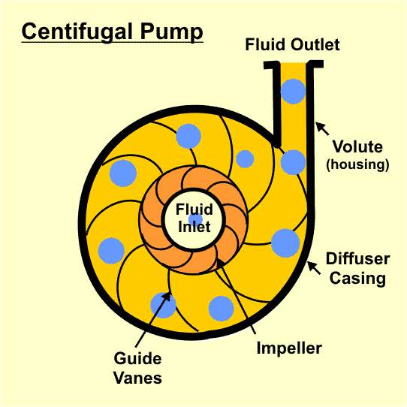
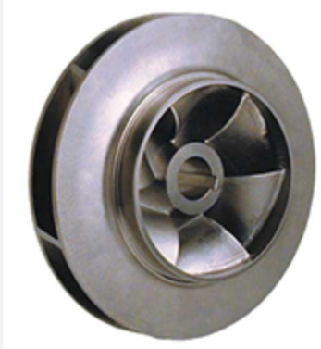
Pump Working Principle
Conversion of mechanical energy into hydraulic energy (Pressure Energy) by virtue of centrifugal force.
Impeller converts driver energy into kinetic energy & diffuser / Casing converts kinetic energy into pressure energy.
A low suction pressure (Fluid) convert into high pressure due to impeller and casing arrangement as per centrifugal force
Pump Application:
    Water transfer (Underground to Overhead tank)
    Gardening
    Sprinkler
    Car wash
    Pressure boost in washroom / Kitchen
    Farming
    Construction site

Slide 4
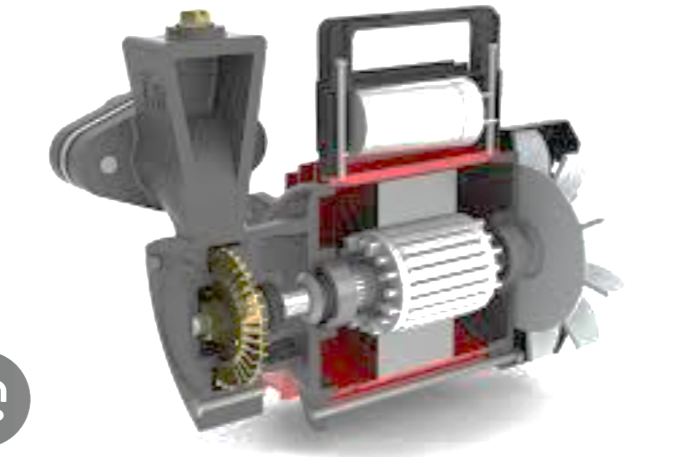

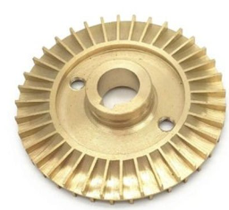
Pump Exploded View
Impeller
Capacitor
Casing
Rotor
Mechanical Seal

Slide 5
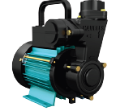
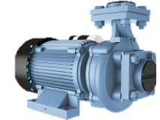
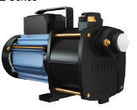
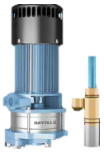
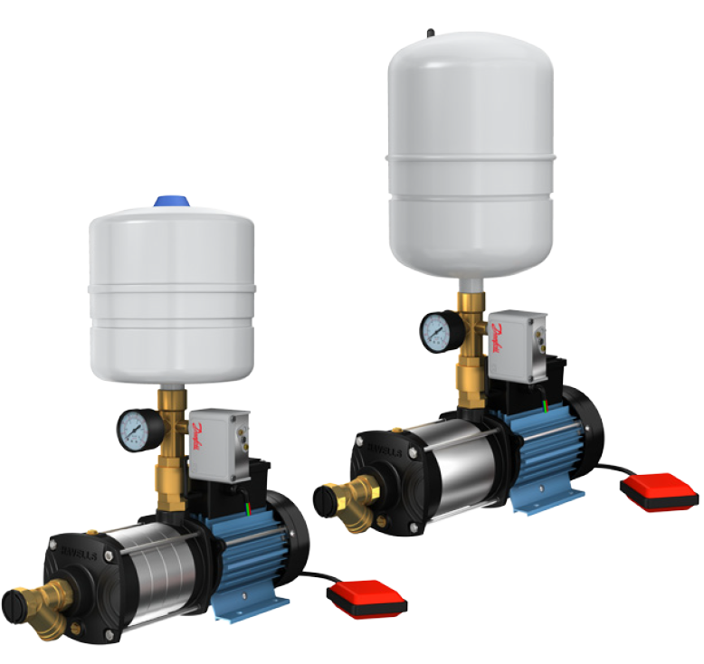

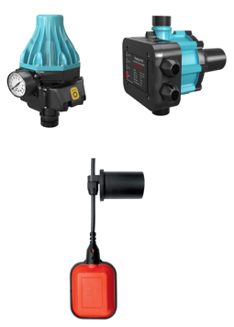
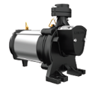
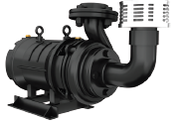
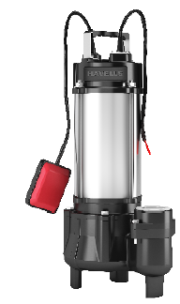
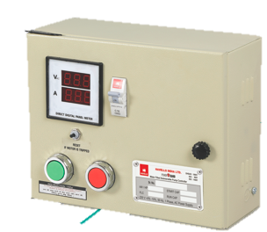
Product Dashboard
Regenerative Monoblock(MP01)
Centrifugal Monoblock(MP06)
Shallow Well(MP03)
Deep Well
Pressure Booster(MP10)
Borewell Submersible(MP07)/MP08)
PressCon Pump Controller
Openwell Submersible-1-Ph(MP05)
Openwell Submersible-3-Ph
Sewage Submersible(MP11)
Float Switch(MP12)
Control Panel(MP09)

Slide 6
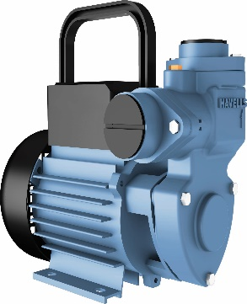

Product Categories (Domestic + Agriculture)
Pumps
Surface Submersible
Regenerative Monoblock (0.5HP ~ 1.5HP) Borewell (0.5HP ~ 25.0HP)
Centrifugal (0.5HP ~ 3.0HP) Openwell (0.5HP ~ 7.5HP)
Shallow well (0.5HP ~ 1.0HP) Sewage (0.5HP ~ 3.0HP)
Deep well (1.0HP) Control Panel (0.5HP ~ 3.0HP)
Pressure Pump (0.5HP ~ 1.5HP)

Slide 7
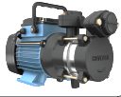
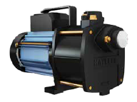
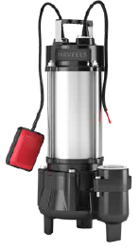
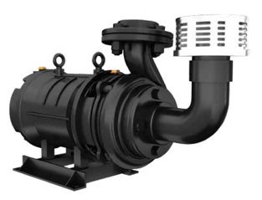
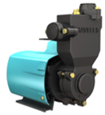
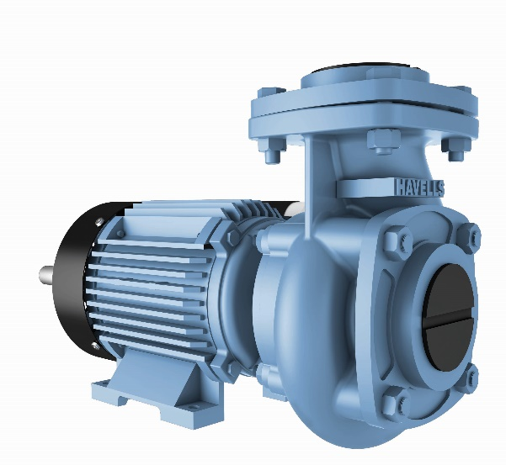
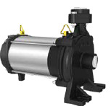
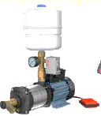
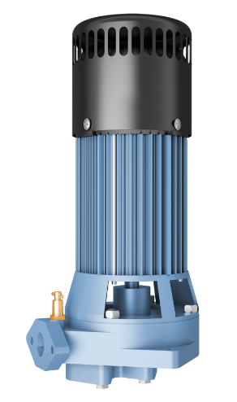
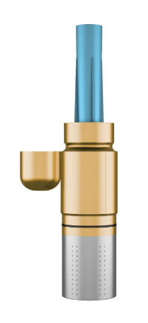
Product Selection
Application
Domestic / Residential Agriculture

Slide 8
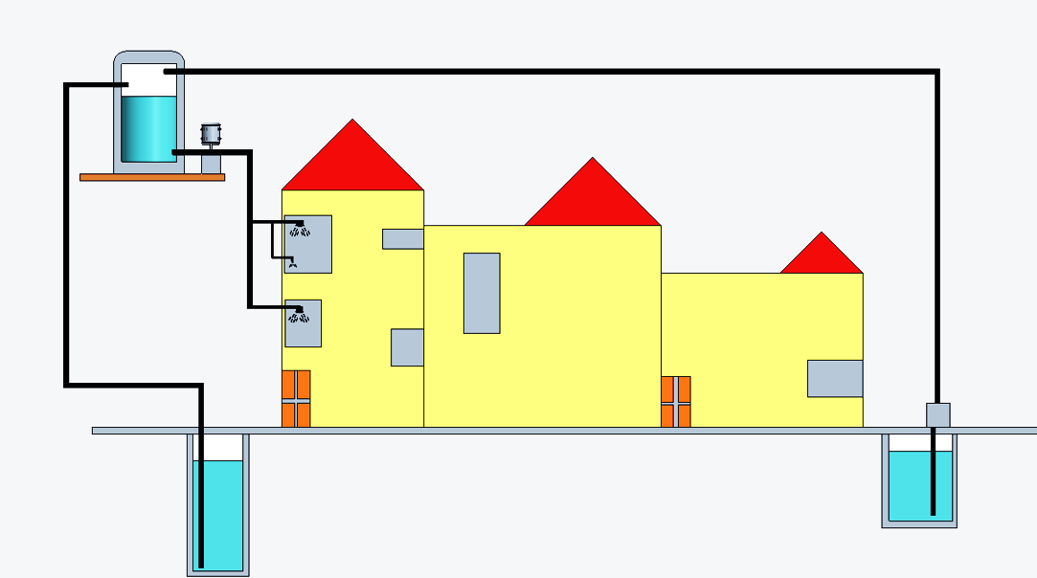
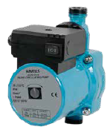
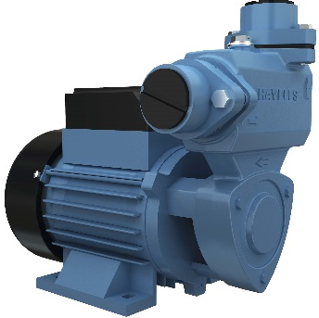

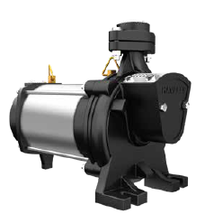
Product Application
Overhead Tank
Ground
Sump
Borewell
Openwell
Sewage
7.5 m

